Slide 1
SQL Lesson 13a
Joining Tables
V1.0 2020

Slide 2
Lesson Objectives
After completing this lesson you will be able to
Access data from multiple tables using various join techniques
Join a table to itself using a self-join
Display data that does not meet join criteria using outer joins
Create a Cartesian product of all rows from two or more tables
Understand old JOIN syntax that no longer conforms to international standards

Slide 3
Joins
Introduction to joins
Natural join
Join using
*Join on*
Cross join
Non-standard join syntax

Slide 4
Introduction to joins
Often, you will need to access data from multiple related tables at one time
A join is used to see this related data stored across several tables
To produce reports of related data, the optimizer must be told how to link the various tables that hold the data
Once the optimizer knows how to link the tables, data can be selected from these tables

Slide 5
Introduction to joins
Employees Departments
Employee_id | Last_name | Department_id
150 | Tucker | 80
151 | Bernstein | 90
152 | Hall | 80
Department_id | Department_Name
80 | Sales
90 | Executive
100 | Finance
Result of JOIN:
Employee_id | Last_name | Department_id | Department_Name
150 | Tucker | 80 | Sales
151 | Bernstein | 90 | Executive
152 | Hall | 80 | Sales

Slide 6
Joins
Introduction to joins
Natural join
Join using
*Join on*
Cross join
Non-standard join syntax

Slide 7
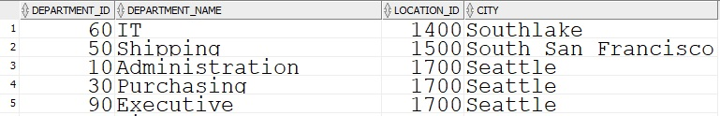
Natural Join
Joins tables based on all columns with the same name and datatype
The optimizer links the two tables by matching the values in the two location_ids
SELECT department_id, department_name, location_id, city
FROM departments NATURAL JOIN locations;

Slide 8
Joins
Introduction to joins
Natural join
Join using
*Join on*
Cross join
Non-standard join syntax

Slide 9
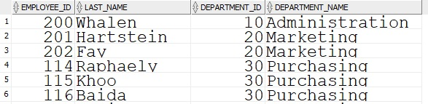
Join using
Joins tables using the common column name that you specify
SELECT employee_id, last_name, department_id, department_name
FROM employees JOIN departments
USING (department_id);

Slide 10
Joins
Introduction to joins
Natural join
Join using
*Join on*
Cross join
Non-standard join syntax

Slide 11
Join on
Join on is the most flexible way to join tables.
It allows you to specify the columns on which to join your tables
Join columns do not need to have the same name
You will explore several ways to use join on syntax:
Equijoin
Three-way join
Applying Extra Conditions to a join
Self-Join
Non equijoin
Outer Joins
Left
Right
Full

Slide 12
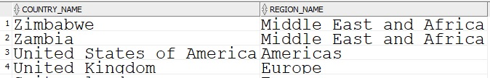
Join on
Equijoin
With Join on, you specify which columns will be linked explicitly in each table
An equijoin merely uses = in the join condition
Equijoins are the most common type of join on
SELECT country_name, region_name
FROM countries JOIN regions
ON countries.region_id = regions.region_id
ORDER BY 1 DESC;
…

Slide 13
Join on
Equijoin with table aliases
Note, in the previous slide, the use of table prefixes to qualify column names that appear in more than one table
A table alias can be used as a shorthand to keep code smaller
SELECT country_name, region_name
FROM countries c JOIN regions r
ON c.region_id = r.region_id
ORDER BY 1 DESC;

Slide 14
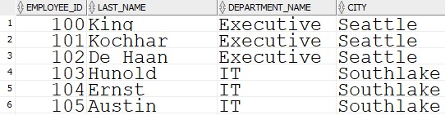
Join on
Three way join
More than two related tables can be joined
SELECT employee_id, last_name, department_name, city
FROM employees JOIN departments
ON employee.department_id = departments.department_id
JOIN locations
ON departments.location_id = locations.location_id;
…

Slide 15
Join on
Applying extra conditions
Use the AND clause or the WHERE clause to apply additional conditions
SELECT employee_id, last_name, department_name
FROM employees e JOIN departments d
ON e.department_id = d.department_id
AND e.department_id IN (50,60);
SELECT employee_id, last_name, department_name
FROM employees e JOIN departments d
ON e.department_id = d.department_id
WHERE e.department_id IN (50,60);

Slide 16
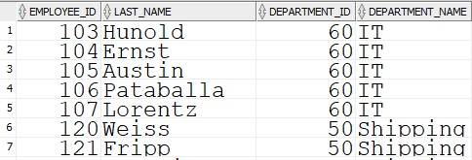
Join on
Applying extra conditions
Use the AND clause or the WHERE clause to apply additional conditions
…

Slide 17
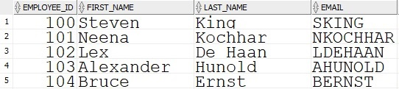
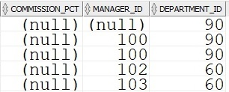
Join on
Self join
You may need to scan more than one row in a table to arrive at an answer
To find the name of the manager of Lex De Haan, you need to scan the employees table twice from left to right
The optimizer can perform this task using a self join
The employees table can be joined to itself
…

Slide 18
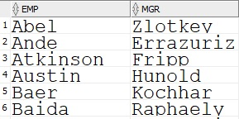
Join on
Self join
SELECT e.last_name as emp, m.last_name as mgr
FROM employees e JOIN employees m
ON e.manager_id = m.employee_id
ORDER BY emp;
…

Slide 19
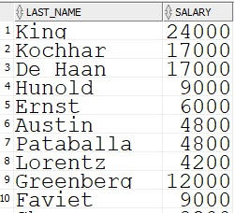
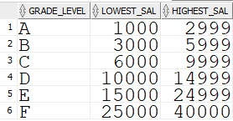
Join on
Non equijoin
Joins can use other operators besides the equality operator =
The employees and sal_grades table tables can illustrate this type of join
Employees |  | Sal_grades

Slide 20


Join on
Non equijoin
An operator such as BETWEEN…AND can be used to display an employee’s salary grade
SELECT grade_level, salary, last_name
FROM employees e JOIN sal_grades s
ON salary BETWEEN lowest_sal AND highest_sal
ORDER BY 1, 2, 3;
…

Slide 21
Join on
Outer joins
Joins that return only matched rows are known as Inner Joins
Outer Joins allow you to display the Inner Join as well as rows that do not meet the join conditions
There are three types of Outer Joins
- Left Outer Joins
- Right Outer Join
- Full Outer Join

Slide 22
Join on
Left outer join
Employees Departments
Employee_id | Last_name | Department_id
178 | Grant
179 | Johnson | 80
180 | Taylor | 50
181 | Fleur | 50
Department_id | Department_Name
50 | Shipping
60 | IT
70 | Public Relations
80 | Sales
Result of LEFT OUTER JOIN:
Employee_id | Last_name | Department_id | Department_Name
178 | Grant
179 | Johnson | 80 | Sales
180 | Taylor | 50 | Shipping
181 | Fleur | 50 | Shipping

Slide 23
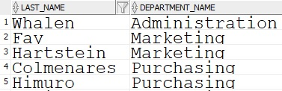
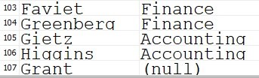
Join on
Left outer join
All rows from the table to the left of the JOIN keyword will be selected as well as any matching rows from the right table.
SELECT last_name, department_name
FROM employees e LEFT OUTER JOIN departments d
ON e.department_id = d.department_id;
… …

Slide 24
Join on
Right outer join
Employees Departments
Employee_id | Last_name | Department_id
178 | Grant
179 | Johnson | 80
180 | Taylor | 50
181 | Fleur | 50
Department_id | Department_Name
50 | Shipping
60 | IT
70 | Public Relations
80 | Sales
Result of RIGHT OUTER JOIN:
Employee_id | Last_name | Department_id | Department_Name
180 | Taylor | 50 | Shipping
181 | Fleur | 50 | Shipping
 |  | 60 | IT
 |  | 70 | Public Relations
179 | Johnson | 80 | Sales

Slide 25
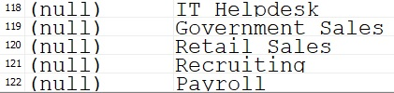
Join on
Right outer join
All rows from the table to the right of the JOIN keyword will be selected as well as any matching rows from the left table
SELECT last_name, department_name
FROM employees e RIGHT OUTER JOIN departments d
ON e.department_id = d.department_id;
… …

Slide 26
Join on
Full outer join
Employees Departments
Employee_id | Last_name | Department_id
178 | Grant
179 | Johnson | 80
180 | Taylor | 50
181 | Fleur | 50
Department_id | Department_Name
50 | Shipping
60 | IT
70 | Public Relations
80 | Sales
Result of FULL OUTER JOIN:
Employee_id | Last_name | Department_id | Department_Name
179 | Johnson | 80 | Sales
180 | Taylor | 50 | Shipping
181 | Fleur | 50 | Shipping
178 | Grant
 |  | 60 | IT
 |  | 70 | Public Relations

Slide 27
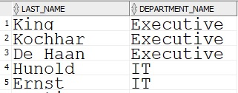


Join on
Full outer join
The Inner Join is displayed as well as any non-matching rows from the left table and the right table
SELECT last_name, department_name
FROM employees e FULL OUTER JOIN departments d
ON e.department_id = d.department_id;
Inner Join
…
…
Left Outer Join
Right Outer Join

Slide 28
Joins
Introduction to joins
Natural join
Join using
*Join on *
Cross join
Non-standard join syntax

Slide 29


Cross join
The Cross Join generates a Cartesian Product
Each row in the first table is shown in combination with each row in the second table
SELECT last_name, department_name
FROM employees CROSS JOIN departments;
…
…

Slide 30
Joins
Introduction to joins
Natural join
Join using
*Join on *
Cross join
Non standard join

Slide 31
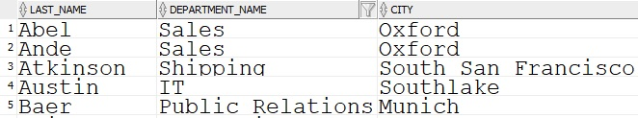
Non standard joins
Prior to 1999, the following syntax was standard
These non-standard joins will be further explored in Lesson 13b Displaying Data From Multiple Tables With Joins.sql
SELECT last_name, department_name, city
FROM employees e, departments d, locations l
WHERE e.department_id = d.department_id
AND d.location_id = l.location_id;
…

Slide 32
Quiz
True or false?
The NATURAL JOIN allows you to specify which columns to join on
JOIN USING requires the tables to have join keys with the same name
JOIN ON is the most flexible way to join tables
OUTER JOINS may give larger results than INNER JOINS.
A Cartesian Product shows every row in the first table in combination with every row in the second table
Non standard joins are prevalent in legacy code

Slide 33
Review
In this lesson you learned how to
Join tables using several ANSI standard techniques
Write outer joins to display matching and non-matching data
Join a table to itself to display hierarchical data
Join more than two related tables
Write joins that use operators other than =
Create Cartesian Products using CROSS JOIN
Recognize and understand non-standard joins

Slide 34
Questions?

